Slide 1
SC-900T00-A Module 1: Describe the Concepts of Security, Compliance, and Identity

Slide 2
Module Agenda
Describe security and compliance concepts and methodologies
Describe identity concepts

Slide 3
Lesson 1: Describe security and compliance concepts and methodologies

Slide 4
Lesson 1 Introduction
After completing this lesson, you'll be able to:
Describe the Zero Trust and shared responsibility models.
Describe common security threats and ways to protect through the defense in-depth security model.
Describe the concepts of encryption and hashing.
Describe the cloud adoption framework.

Slide 5
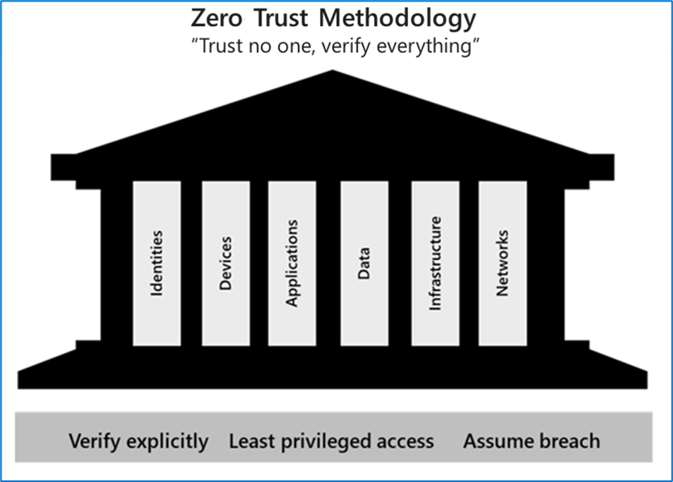
Zero-trust methodology
Zero Trust guiding principles
Verify explicitly
Least privileged access
Assume breach
Six foundational pillars
Identities may be users, services, or devices.
Devices create a large attack surface as data flows.
Applications are the way that data is consumed.
Data should be classified, labeled, and encrypted based on its attributes.
Infrastructure whether on-premises or cloud based, represents a threat vector.
Networks should be segmented.
Notes:
Zero Trust methodology:
https://www.microsoft.com/videoplayer/embed/RE4J3ms
Zero Trust assumes everything is on an open and untrusted network, even resources behind the firewalls of the corporate network. The Zero Trust model operates on the principle of “trust no one, verify everything.”
Attackers’ ability to bypass conventional access controls is ending any illusion that traditional security strategies are sufficient. By no longer trusting the integrity of the corporate network, security is strengthened.
In practice, this means that we no longer assume that a password is sufficient to validate a user but add multi-factor authentication to provide additional checks. Instead of granting access to all devices on the corporate network, users are allowed access only to the specific applications or data that they need.
Zero Trust: A zero-trust approach to security transforms the security model into one that has 3 basic tenants:
verifies explicitly based on all available signals
Employs the principle of least privilege access
And assumes breach
This approach should extend throughout the entire digital estate and serves not just as a security philosophy – it also serves as an end-to-end strategy based on six foundational pillars:
Identities – verify all identities with strong authentication.
Devices – it is important to get visibility into all the devices accessing your network
Applications – this includes being able to discover shadow IT, the ability to control access to applications, and monitor access with real-time analytics.
Network – this includes encryption of all your communications, limiting access by policies, and network segmentation.
Infrastructure – this includes employing real-time threat detection, automatically detecting, blocking, and flagging risks, and employ least privilege access principles
And Data – this includes being able to classify, label, and encrypt data, wherever it lives or travels.

Slide 6
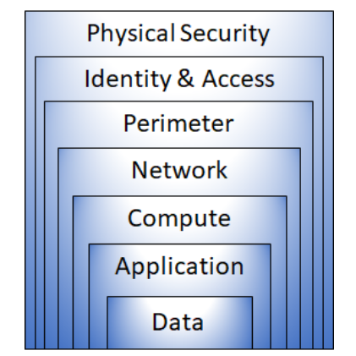
Defense in depth
Defense in depth uses a layered approach to security:
Physical security such as limiting access to a datacenter to only authorized personnel.
Identity and access security controlling access to infrastructure and change control.
Perimeter security including distributed denial of service (DDoS) protection to filter large-scale attacks before they can cause a denial of service for users.
Network security can limit communication between resources using segmentation and access controls.
The compute layer can secure access to virtual machines either on-premises or in the cloud by closing certain ports.
Application layer security ensures that applications are secure and free of security vulnerabilities.
Data layer security controls access to business and customer data, and encryption to protect data.
Notes:
Defense in depth uses a layered approach to security, rather than relying on a single perimeter. A defense in-depth strategy uses a series of mechanisms to slow the advance of an attack. Each layer provides protection so that, if one layer is breached, a subsequent layer will prevent an attacker getting unauthorized access to data.
Example layers of security might include:
Physical security such as limiting access to a datacenter to only authorized personnel.
Identity and access security controlling access to infrastructure and change control.
Perimeter security including distributed denial of service (DDoS) protection to filter large-scale attacks before they can cause a denial of service for users.
Network security can limit communication between resources using segmentation and access controls.
The compute layer can secure access to virtual machines either on-premises or in the cloud by closing certain ports.
Application layer security ensures that applications are secure and free of security vulnerabilities.
Data layer security controls access to business and customer data, and encryption to protect data.

Slide 7
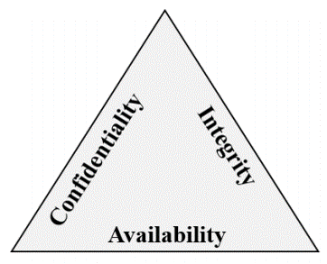
Confidentiality, Integrity, Availability (CIA)
CIA - A way to think about security trade-offs.
Confidentiality refers to the need to keep confidential sensitive data such as customer information, passwords, or financial data.
Integrity refers to keeping data or messages correct.
Availability refers to making data available to those who need it.
Notes:
Confidentiality, Integrity, Availability (CIA)
Confidentiality refers to the need to keep confidential sensitive data such as customer information, passwords, or financial data. You can encrypt data to keep it confidential, but then you also need to keep the encryption keys confidential. Confidentiality is the most visible part of security; we can clearly see need for sensitive data, keys, passwords, and other secrets to be kept confidential.
Integrity refers to keeping data or messages correct. When you send an email message, you want to be sure that the message received is the same as the message you sent. When you store data in a database, you want to be sure that the data you retrieve is the same as the data you stored. Encrypting data keeps it confidential, but you must then be able to decrypt it so that it's the same as before it was encrypted. Integrity is about having confidence that data hasn't been tampered with or altered.
Availability refers to making data available to those who need it. It's important to the organization to keep customer data secure, but at the same time it must also be available to employees who deal with customers. While it might be more secure to store the data in an encrypted format, employees need access to decrypted data.

Slide 8
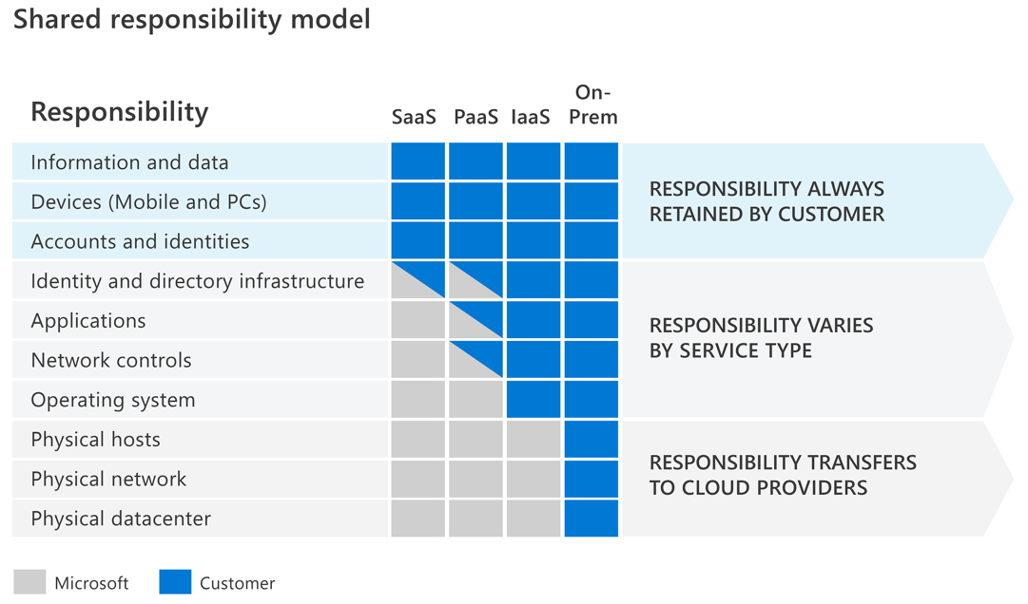
The shared responsibility model
The responsibilities vary based on where the workload is hosted:
Software as a Service (SaaS)
Platform as a Service (PaaS)
Infrastructure as a Service (IaaS)
On-premises datacenter (On-prem)
Notes:
The shared responsibility model identifies which security tasks are handled by the cloud provider, and which security tasks are handled by you, the customer.
The responsibilities vary depending on where the workload is hosted:
Software as a Service (SaaS)
Platform as a Service (PaaS)
Infrastructure as a Service (IaaS)
On-premises datacenter (On-prem)
On-premises datacenters
In an on-premises datacenter, you have responsibility for everything from physical security to encrypting sensitive data.
Infrastructure as a Service (IaaS)
Of all cloud services, IaaS requires the most management by the cloud customer. With IaaS, you're using the cloud provider’s computing infrastructure. The cloud customer isn't responsible for the physical components, such as computers and the network, or the physical security of the datacenter. However, the cloud customer still has responsibility for software components such as operating systems, network controls, applications, and protecting data.
Platform as a Service (PaaS)
PaaS provides an environment for building, testing, and deploying software applications. The goal of PaaS is to help you create an application quickly without managing the underlying infrastructure. With PaaS, the cloud provider manages the hardware and operating systems, and the customer is responsible for applications and data.
Software as a Service (SaaS)
SaaS is hosted and managed by the cloud provider, for the customer. It's usually licensed through a monthly or annual subscription. Microsoft 365, Skype, and Dynamics CRM Online are all examples of SaaS software. SaaS requires the least amount of management by the cloud customer. The cloud provider is responsible for managing everything except data, devices, accounts, and identities.
For all cloud deployment types you, the cloud customer, own your data and identities. You're responsible for protecting the security of your data and identities, and on-premises resources.
In summary, responsibilities always retained by the customer organization include:
Information and data
Devices (mobile and PCs)
Accounts and identities

Slide 9
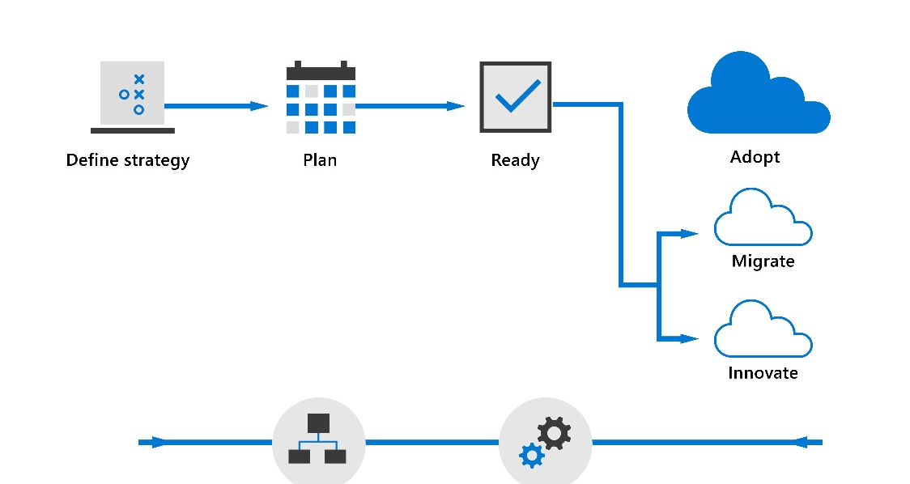
Microsoft Cloud Adoption Framework
Microsoft Cloud Adoption Framework
Consists of documentation, implementation guidance, & best practices that support increased security and compliance
Help businesses implement strategies necessary to succeed in the cloud.
Lifecycle
Define strategy
Plan
Ready
Adopt (Migrate / Innovate)
Govern
Manage
Notes:
Another methodology/framework that we need to introduce, and which supports increased security and compliance is Microsoft’s Cloud adoption framework
The Cloud Adoption Framework has been carefully designed based on cloud adoption best practices from Microsoft employees, customers, and partners. It provides a proven and consistent methodology for implementing cloud technologies.
View this two-minute video to learn more about the cloud adoption lifecycle. https://www.microsoft.com/videoplayer/embed/RE4tyzr
Each of the following steps is part of the cloud adoption lifecycle
Strategy: define business justification and expected outcomes of adoption.
Plan: align actionable adoption plans to business outcomes.
Ready: Prepare the cloud environment for the planned changes.
Adopt
Migrate: Migrate and modernize existing workloads.
Innovate: Develop new cloud-native or hybrid solutions.
Govern: Govern the environment and workloads.
Manage: Operations management for cloud and hybrid solutions.

Slide 10
Common threats
Data breach
Include:
Phishing
Spear phishing
Tech support scams
SQL injection
Malware designed to steal passwords or bank details.
Dictionary attack
It is a type of identity attack.
A hacker attempts to steal an identity by trying a large number of known passwords.
Dictionary attacks are also known as brute force attacks.
Ransomware
It is a type of malware that encrypts files and folders.
It attempts to extort money from victims.
Disruptive attacks
A Distributed Denial of Service (DDoS) attack attempts to exhaust an application's resources.
DDoS attacks can be targeted at any endpoint.
Other common threats include coin miners, rootkits, trojans, worms, and exploits and exploit kits.
Notes:
Other common threats
Rootkits intercept and change standard operating system processes. After a rootkit infects a device, you can’t trust any information that the device reports about itself.
Trojans are a common type of malware which can’t spread on their own. This means they either have to be downloaded manually or another malware needs to download and install them. Trojans often use the same file names as real and legitimate apps so it's easy to accidentally download a trojan thinking that it is legitimate.
A worm is a type of malware that can copy itself and often spreads through a network by exploiting security vulnerabilities. It can spread through email attachments, text messages, file-sharing programs, social networking sites, network shares, removable drives, and software vulnerabilities.
Exploits take advantage of vulnerabilities in software. A vulnerability is like a hole in your software that malware uses to get onto your device. Malware exploits these vulnerabilities to bypass your computer's security safeguards and infect your device.

Slide 11
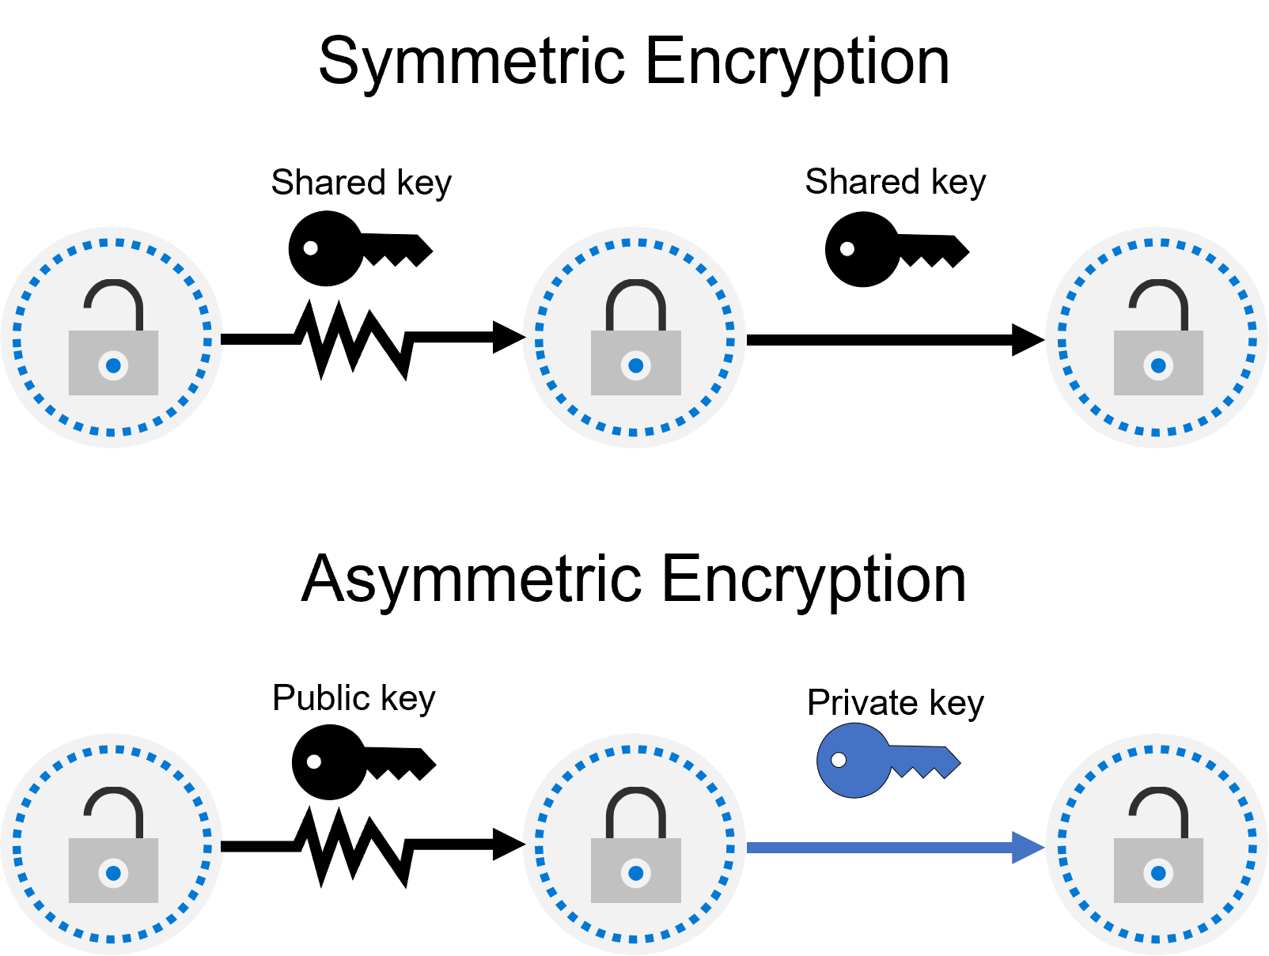
Encryption
Encryption is the process of making data unreadable and unusable to unauthorized viewers.
Encryption of data at rest
Encryption of data in transit
Two top-level types of encryption:
Symmetric – uses same key to encrypt and decrypt data
Asymmetric - uses a public key and private key pair
Notes:
One way to mitigate against common cybersecurity threats is to encrypt sensitive or valuable data. Encryption is the process of making data unreadable and unusable to unauthorized viewers. To use or read encrypted data, it must be decrypted, which requires the use of a secret key.
There are two top-level types of encryption: symmetric and asymmetric. Symmetric encryption uses the same key to encrypt and decrypt the data. Asymmetric encryption uses a public key and private key pair. Either key can encrypt data, but a single key can’t be used to decrypt encrypted data. To decrypt, you need a paired key. Asymmetric encryption is used for things like Transport Layer Security (TLS), such as the HTTPS protocol, and data signing. Encryption may protect data at rest, or in transit.
Encryption at rest
Data at rest is the data that's stored on a physical device, such as a server. It may be stored in a database or a storage account but, regardless of where it's stored, encryption of data at rest ensures the data is unreadable without the keys and secrets needed to decrypt it.
If an attacker obtained a hard drive with encrypted data and didn't have access to the encryption keys, they would be unable to read the data.
Encryption in transit
Data in transit is the data moving from one location to another, such as across the internet or through a private network. Secure transfer can be handled by several different layers. It could be done by encrypting the data at the application layer before sending it over a network. HTTPS is an example of encryption in transit.
Encrypting data in transit protects it from outside observers and provides a mechanism to transmit data while limiting the risk of exposure.

Slide 12
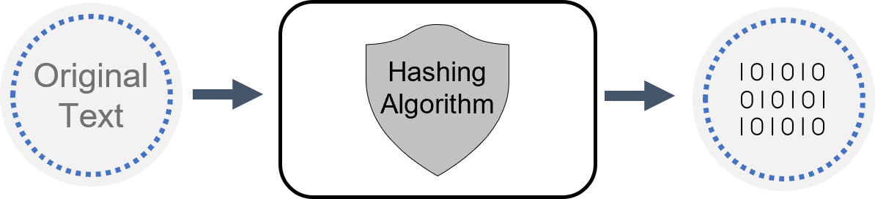
Hashing
Hashing uses an algorithm to convert the original text to a unique fixed-length hash value. Hash functions are:
Deterministic, the same input produces the same output.
A unique identifier of its associated data.
Different to encryption in that the hashed value isn't subsequently decrypted back to the original.
Used to store passwords. The password is “salted” to mitigate risk of brute-force dictionary attack.
Notes:
Hashing
Hashing uses an algorithm to convert the original text to a unique fixed-length hash value. Each time the same text is hashed using the same algorithm, the same hash value is produced. That hash can then be used as a unique identifier of its associated data.
Hashing is different to encryption in that it doesn't use keys, and the hashed value isn't subsequently decrypted back to the original.
Hashing is used to store passwords. When a user enters their password, the same algorithm that created the stored hash creates a hash of the entered password. This is compared to the stored hashed version of the password. If they match, the user has entered their password correctly. This is more secure than storing plain text passwords, but hashing algorithms are also known to hackers. Because hash functions are deterministic (the same input produces the same output), hackers can use brute-force dictionary attacks by hashing the passwords. For every matched hash, they know the actual password. To mitigate this risk, passwords are often “salted”. This refers to adding a fixed-length random value to the input of hash functions to create unique hashes for every input. As hackers can't know the salt value, the hashed passwords are more secure.

Slide 13
Lesson 2: Describe identity concepts

Slide 14
Lesson 2 Introduction
After completing this module, you’ll be able to:
Describe the concept of identity as a security perimeter
Understand the difference between authentication and authorization
Describe identity-related services

Slide 15
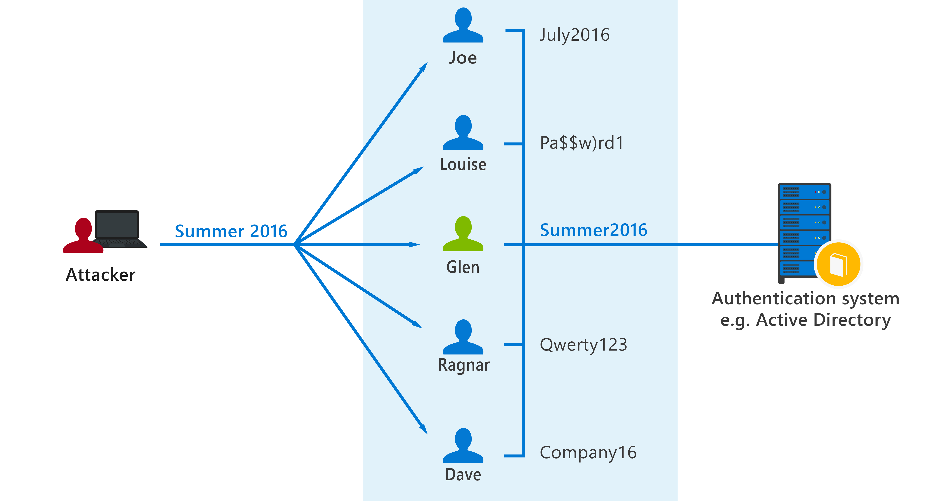
Common identity attacks
Types of security threats:
Password-based attacks
Phishing
Spear phishing
Notes:
Password-based attacks
Password-based attacks include password spray attacks and brute force attacks. A password spray attack attempts to match a username against a list of weak passwords.
Phishing
A phishing attack is when a hacker sends an email that appears to come from a reputable source. The email contains a credible story, such as a security breach, instructing the user to sign in and change their password. Instead of going to a legitimate website, the user is directed to the scammer’s website where they enter their username and password. The hacker has now captured the user’s identity, and their password.
Spear phishing
A spear phishing scam is a variant on phishing. Hackers build databases of information about users, which can be used to create highly credible emails. The email may appear to come from someone in your organization who is requesting information.

Slide 16
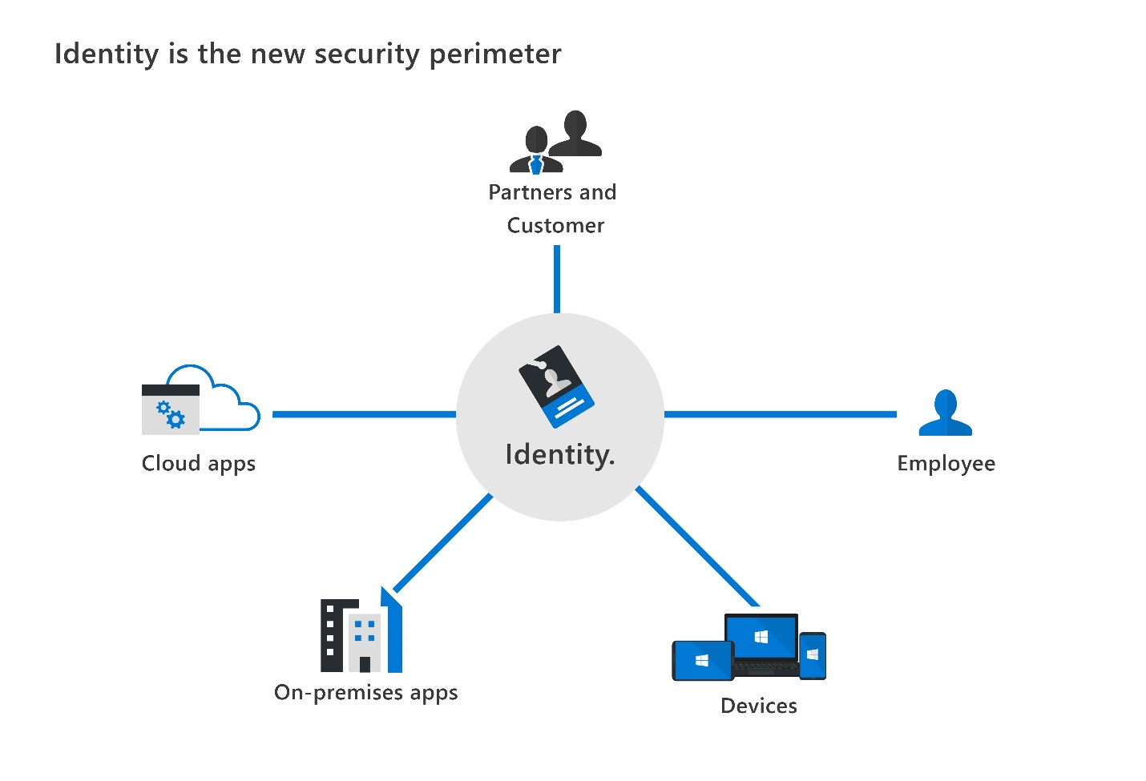
Identity as the primary security perimeter
Identity has become the new security perimeter that enables organizations to secure their assets.
An identity is how someone or something can be verified and authenticated and may be associated with:
User
Application
Device
Other
Four pillars of identity:
Administration
Authentication
Authorization
Auditing
Notes:
Enterprise security needs to adapt to this new reality. The security perimeter can no longer be viewed as the on-premises network. It now extends to:
SaaS applications for business-critical workloads that might be hosted outside the corporate network.
The personal devices that employees are using to access corporate resources (BOYD, or bring your own device) while working from home.
The unmanaged devices used by partners or customers when interacting with corporate data or collaborating with employees
IoT devices installed throughout your corporate network and inside customer locations.
Administration. Administration is about the creation and management of identities for users, devices, and services. As an administrator, you manage how and under what circumstances the characteristics of identities can change (be created, updated, deleted).
Authentication. The authentication pillar tells the story of how much assurance for a particular identity is enough. In other words, how much does an IT system need to know about an identity to have sufficient proof that they really are who they say they are? It involves the act of challenging a party for legitimate credentials. Authentication is sometimes shortened to AuthN.
Authorization. The authorization pillar is about processing the incoming identity data to determine the level of access an authenticated person or service has within the application or service that it wants to access. Authorization is sometimes shortened to AuthZ.
Auditing. The auditing pillar is about tracking who does what, when, where, and how. Auditing includes having in-depth reporting, alerts, and governance of identities.

Slide 17
Modern authentication and the role of the identity provider
Modern authentication is an umbrella term for authentication and authorization methods between a client and a server.
At the center of modern authentication is the role of the identity provider (IdP).
IdP offers authentication, authorization, and auditing services.
IdP enables organizations to establish authentication and authorization policies, monitor user behavior, and more.
A fundamental capability of an IdP and “modern authentication” is the support for single sign-on (SSO).
Microsoft Azure Active Directory is an example of a cloud-based identity provider.
Notes:
Modern authentication is an umbrella term for authentication and authorization methods between a client, such as your laptop or phone, and a server, like a website or application. At the center of modern authentication is the role of the identity provider. An identity provider creates, maintains, and manages identity information while offering authentication, authorization, and auditing services.
With modern authentication, all services, including all authentication services, are supplied by a central identity provider. Information that's used to authenticate the user with the server is stored and managed centrally by the identity provider.
With a central identity provider, organizations can establish authentication and authorization policies, monitor user behavior, identify suspicious activities, and reduce malicious attacks.
Watch this video, https://www.microsoft.com/videoplayer/embed/RE4Kdt9, for more information about modern authentication and how it works with a central identity provider.
As you see in the video, thanks to modern authentication, the client communicates with the identity provider by giving an identity that can be authenticated. When the identity (which can be a user or an application) has been verified, the identity provider issues a security token that the client sends to the server.
The server validates the security token through its trust relationship with the identity provider. By using the security token and the information that's contained within it, the user or application accesses the required resources on the server. In this scenario, the token and the information it contains is stored and managed by the identity provider. The centralized identity provider is supplying the authentication service.
Microsoft Azure Active Directory is an example of a cloud-based identity provider. Other examples include Twitter, Google, Amazon, LinkedIn, and GitHub.
Single sign-on
Another fundamental capability of an identity provider and “modern authentication” is the support for single sign-on (SSO). With SSO, the user logs in once and that credential is used to access multiple applications or resources. When you set up SSO between multiple identity providers, it's called federation.

Slide 18
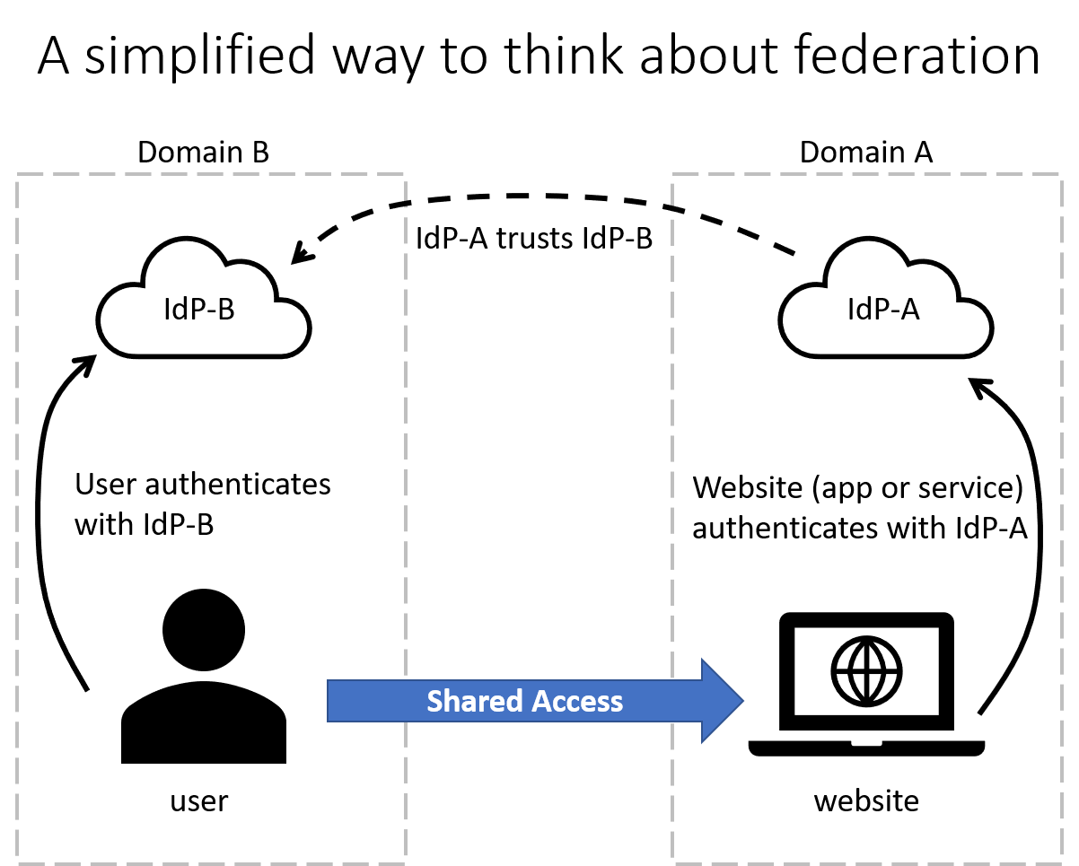
The concept of Federated Services
Simplification method of federation scenario:
The website uses the authentication services of IdP-A
The user authenticates with IdP-B
IdP-A has a trust relationship configured with IdP-B
When the user’s credentials are passed to the website, the website trusts the user and allows access
Notes:
Federation enables the access of services across organizational or domain boundaries by establishing trust relationships between the respective domain’s identity provider. With federation, there's no need for a user to maintain a different username and password when accessing resources in other domains.
The simplified way to think about this federation scenario is as follows:
The website uses the authentication services of IdP-A.
The user authenticates with IdP-B.
IdP-A has a trust relationship configured with IdP-B.
When the user’s credentials are passed to the website, the website trusts the user and allows access.
With federation, trust isn't always bidirectional. Although IdP-A may trust IdP-B and allow the user in domain B to access the website in domain A, the opposite isn't true, unless that trust relationship is configured.
A common example of federation in practice is when a user logs in to a third-party site with their social media account, such as Twitter. In this scenario, Twitter is an identity provider, and the third-party site might be using a different identity provider, such as Azure AD. There's a trust relationship between Azure AD and Twitter.

Slide 19
The concept of directory services and Active Directory
A directory is a hierarchical structure that stores information about objects on the network.
A directory service stores directory data and makes it available to network users, administrators, services, and applications.
The best-known service of this kind is Active Directory Domain Services (AD DS), a central component in organizations with on-premises IT infrastructure.
Azure Active Directory is the evolution of identity and access management solutions, providing organizations an Identity as a Service (IDaaS) solution for all their apps across cloud and on-premises.
Notes:
In the context of a computer network, a directory is a hierarchical structure that stores information about objects on the network. A directory service stores directory data and makes it available to network users, administrators, services, and applications.
Active Directory (AD) is a set of directory services developed by Microsoft as part of Windows 2000 for on-premises domain-based networks. The best-known service of this kind is Active Directory Domain Services (AD DS). It stores information about members of the domain, including devices and users, verifies their credentials, and defines their access rights. A server running AD DS is a domain controller (DC).
AD DS is a central component in organizations with on-premises IT infrastructure. AD DS gives organizations the ability to manage multiple on-premises infrastructure components and systems using a single identity per user. AD DS doesn't, however, natively support mobile devices, SaaS applications, or line of business apps that require modern authentication methods.
The growth of cloud services, SaaS applications, and personal devices being used at work, has resulted in the need for modern authentication, and an evolution of Active Directory-based identity solutions.
Azure Active Directory is the next evolution of identity and access management solutions. It provides organizations with an Identity as a Service (IDaaS) solution for all their apps across cloud and on-premises. In this course, we'll focus on Azure AD, Microsoft’s cloud-based identity provider.
To learn more about the differences between Active Directory concepts and Azure Active Directory, see Compare Active Directory to Azure Active Directory in the Learn More section below.

Slide 20
Module Summary
In this module, you have:
Learned about some important security concepts and methodologies.
Learned about the Zero Trust methodology, the guiding principles and the six foundational elements used in the Zero Trust model.
Looked at the shared responsibility model.
Learned about defense in depth and the tradeoffs associated with CIA triad.
Learned about common cybersecurity threats including threats to business and personal data.
Learned about some important identity concepts.
Learned about the concept of identity as a security perimeter & the four pillars of identity
Learned about identity-related services, including the role of identity provider, federation, and directory services

Slide 21
Closing slide

